Slide 1
Shimmer3 IMU Research

Slide 2
Project Outline
Hardware Requirements
Shimmer3 IMU Device.
Windows 10 PC/Laptop
Mac OS Version 10.13 or Later
Investigate gathering real time data from Shimmer3 IMU device for use with 3D model rotation and data analysis from player movement in a training scenario.
This application will target Rugby specifically and aims to prevent injury by identifying danger areas while tackling.
Facilitate post analysis of the data with the player and assist players to perform, learn and practice safe tackling in a training environment.
Identify limitations with hardware or software applications.
Record findings and determine viability as a useable application.
Software Requirements
Unity 3D

Slide 3
Project Architecture
Developed in Unity
Here you have a list of items
And some text
But remember not to overload your slides with content
Your audience will listen to you or read the content, but won’t do both.

Slide 4
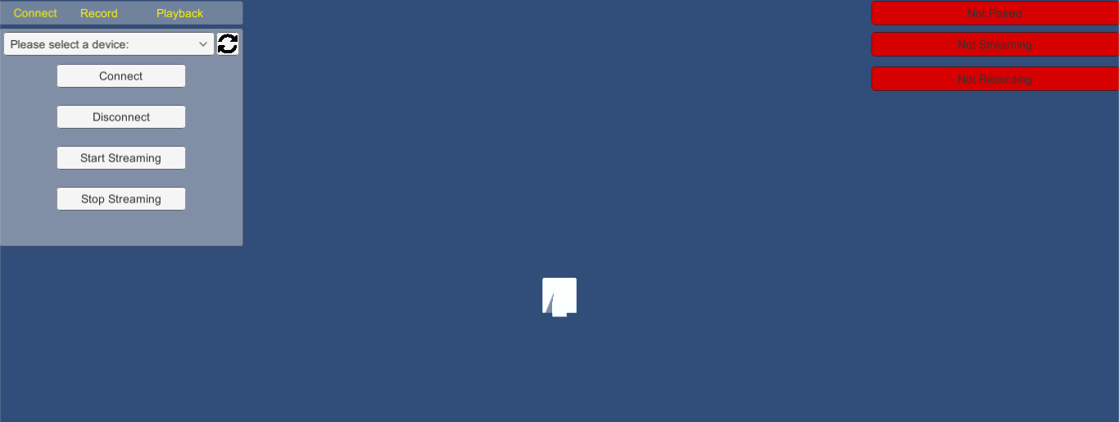
The Application

Slide 5
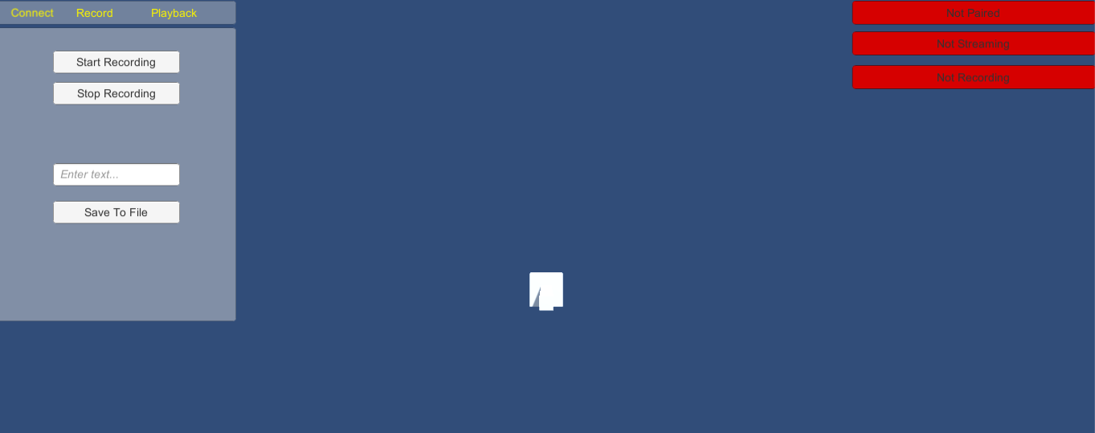
DESKTOP Application
Show and explain your web, app or software projects using these gadget templates.

Slide 6
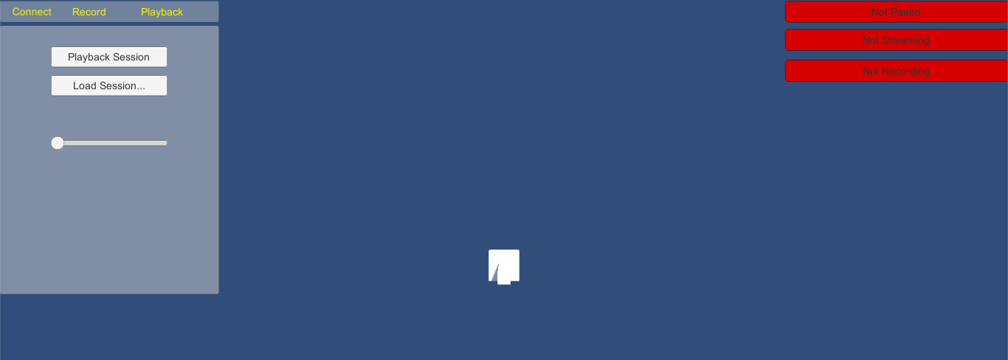
DESKTOP Application
Show and explain your web, app or software projects using these gadget templates.

Slide 7
Quotations are commonly printed as a means of inspiration and to invoke philosophical thoughts from the reader.

Slide 8
BIG CONCEPT
Bring the attention of your audience over a key concept using icons or illustrations

Slide 9
YOU CAN ALSO SPLIT YOUR CONTENT
White
Is the color of milk and fresh snow, the color produced by the combination of all the colors of the visible spectrum.
Black
Is the color of coal, ebony, and of outer space. It is the darkest color, the result of the absence of or complete absorption of light.

Slide 10
IN TWO OR THREE COLUMNS
Yellow
Is the color of gold, butter and ripe lemons. In the spectrum of visible light, yellow is found between green and orange.
Blue
Is the colour of the clear sky and the deep sea. It is located between violet and green on the optical spectrum.
Red
Is the color of blood, and because of this it has historically been associated with sacrifice, danger and courage.

Slide 11

A PICTURE IS WORTH A THOUSAND WORDS
A complex idea can be conveyed with just a single still image, namely making it possible to absorb large amounts of data quickly.

Slide 12
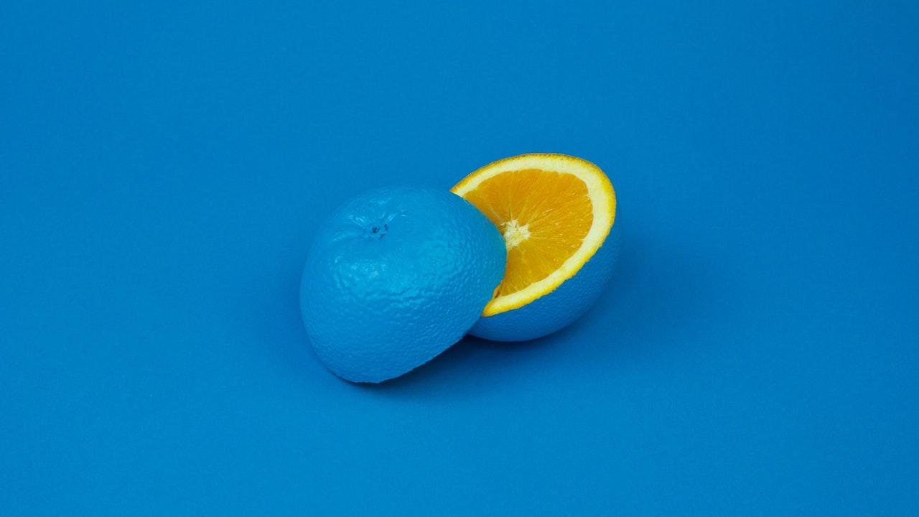
Want big impact?
USE BIG IMAGE.

Slide 13
LET’S REVIEW SOME CONCEPTS
Yellow
Is the color of gold, butter and ripe lemons. In the spectrum of visible light, yellow is found between green and orange.
Blue
Is the colour of the clear sky and the deep sea. It is located between violet and green on the optical spectrum.
Red
Is the color of blood, and because of this it has historically been associated with sacrifice, danger and courage.
Yellow
Is the color of gold, butter and ripe lemons. In the spectrum of visible light, yellow is found between green and orange.
Blue
Is the colour of the clear sky and the deep sea. It is located between violet and green on the optical spectrum.
Red
Is the color of blood, and because of this it has historically been associated with sacrifice, danger and courage.

Slide 14
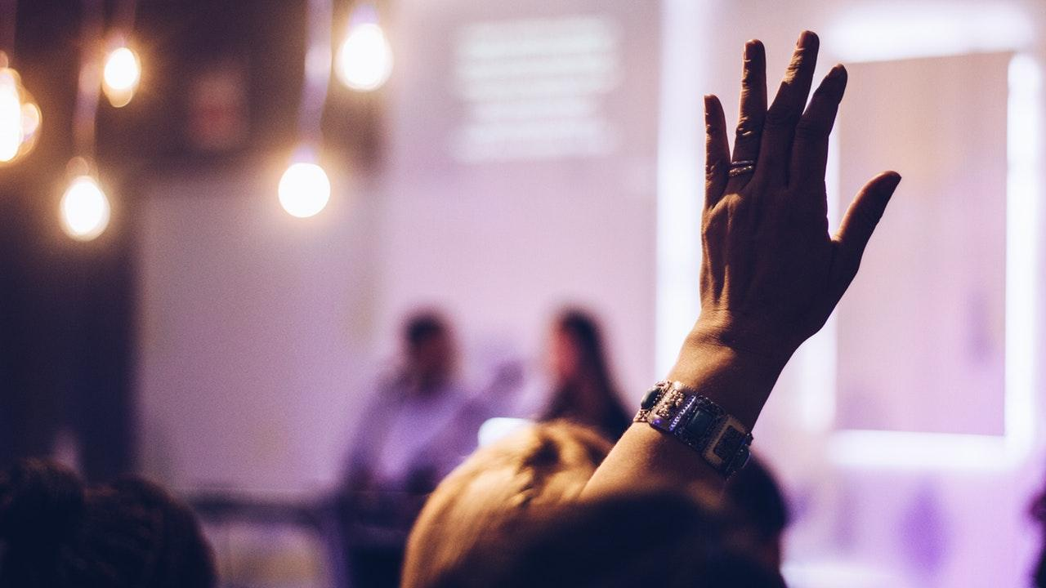
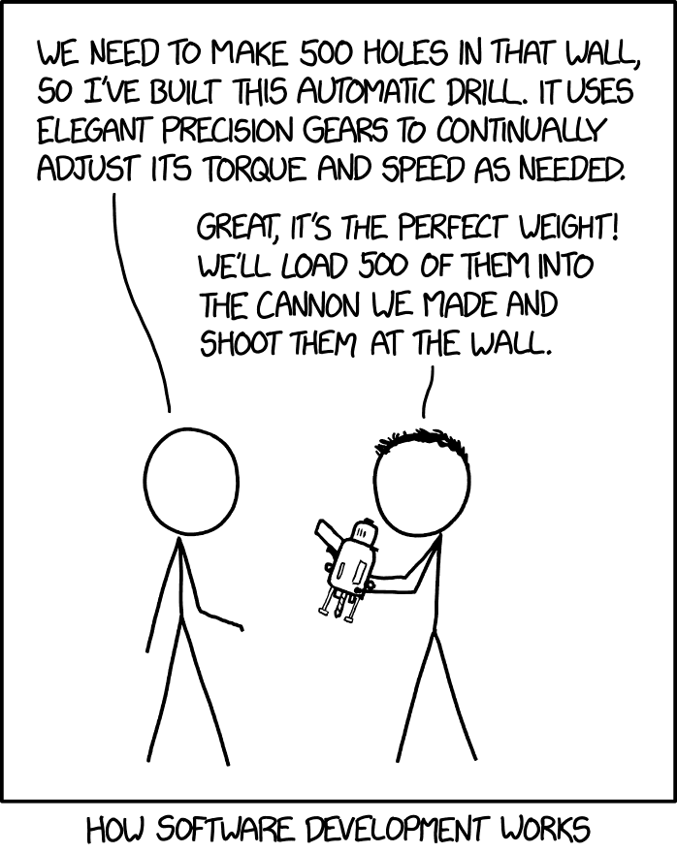
THANKS!
Any questions?
Contact:
Justin – 10023036@gmit.ie
David – G00351365@gmit.ie

Slide 15
CREDITS
Special thanks to all the people who made and released these awesome resources for free:
Presentation template by SlidesCarnival
Photographs by Unsplash

Slide 16
PRESENTATION DESIGN
This presentation uses the following typographies and colors:
Titles: Miriam Libre
Body copy: Barlow Light
You can download the fonts on these pages:
https://github.com/MichalSahar/Miriam-Libre/tree/master/fonts/otf
https://www.fontsquirrel.com/fonts/barlow
Indigo #a5b0fe
You don’t need to keep this slide in your presentation. It’s only here to serve you as a design guide if you need to create new slides or download the fonts to edit the presentation in PowerPoint®

Slide 17
EXTRA GRAPHICS

Slide 18
SlidesCarnival icons are editable shapes.
This means that you can:
Resize them without losing quality.
Change line color, width and style.
Isn’t that nice? :)
Examples:

Slide 19
😉
Now you can use any emoji as an icon!
And of course it resizes without losing quality and you can change the color.
How? Follow Google instructions https://twitter.com/googledocs/status/730087240156643328
✋👆👉👍👤👦👧👨👩👪💃🏃💑❤😂😉😋😒😭👶😸🐟🍒🍔💣📌📖🔨🎃🎈🎨🏈🏰🌏🔌🔑 and many more...

